Slide 1
Hashing Algorithm
If you know the index number of a value in an array you can look it up in O(1) time
Figure out a way so that each index number is somehow related to the data
Each index number can be calculated by using the value itself
Find Ada; Ada is in index 8, mydata = array[8], we can get Ada at 0(1) time

Slide 2
Hashing Algorithm
 |  | ASCII |  | ASCII |  | ASCII |  | Tablesize
Mia | M | 77 | i | 105 | a | 97 | 279 | 11 | 4
Tim | T | 84 | i | 105 | m | 109 | 298 | 11 | 1
Bea | B | 66 | e | 101 | a | 97 | 264 | 11 | 0
Zoe | Z | 90 | o | 111 | e | 101 | 302 | 11 | 5
Jan | J | 74 | a | 97 | n | 110 | 281 | 11 | 6
Ada | A | 65 | d | 100 | a | 97 | 262 | 11 | 9
Leo | L | 76 | e | 101 | o | 111 | 288 | 11 | 2
Sam | S | 83 | a | 97 | m | 109 | 289 | 11 | 3
Lou | L | 76 | o | 111 | u | 117 | 304 | 11 | 7
Max | M | 77 | a | 97 | x | 120 | 294 | 11 | 8
Ted | T | 84 | e | 101 | d | 100 | 285 | 11 | 10
[0]
[1]
[2]
[3]
[4]
[5]
[6]
[7]
[8]
[9]
[10]
Bae
Tim
Leo
Sam
Mia
Zoe
Jan
Lou
Max
Ada
Ted
Each person can be the object /instance of a class and you can store all variables and functions associated with that object.

Slide 3
Hashing Algorithm
A hash function applied to a key of a very large number or a long string to transform it into an address
For numeric keys, divide the key by the number of available addresses, n, and take the remainder
      Address = key Mod n
For alphanumeric keys, divide the sum of ASCII codes in a key by the number of available addresses, n, and take the remainder
There are many Hashing Algorithms to choose from depending on the nature of your data.

Slide 4
Example
Hash
Table
0
key
1
Items
H(X) =
xmod 10
2
10
3
20
4
30
5
40
6
7
50
8
60
9
70
H(X) = X % TS

Slide 5
Example
Hash
Table
0
49
key
1
58
Items
H(X) =
xmod 10
2
9
89
3
18
4
49
5
58
6
7
9
8
18
9
89
H(X) = X % TS

Slide 6
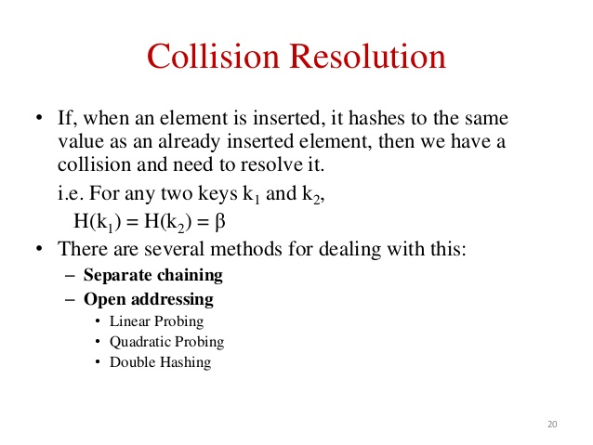
. . .
Notes:
Instead we must somehow mark the location as "a location that used to have something here, but no longer does."
We might do this by using some other special value for the Number field of the record.
In any case, a search can not stop when it reaches "a location that used to have something here". A search can only stop when it reaches a true empty spot.

Slide 7
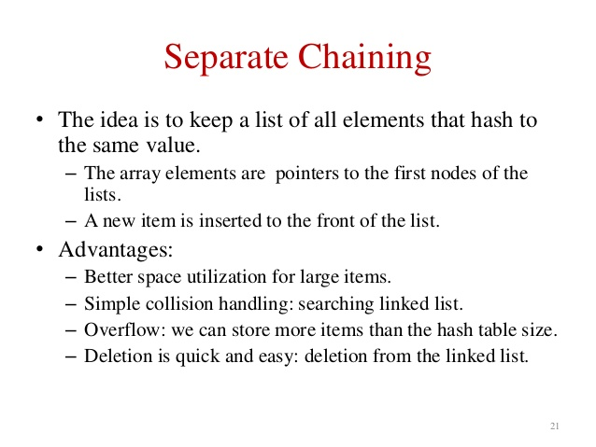
. . .
Notes:
Instead we must somehow mark the location as "a location that used to have something here, but no longer does."
We might do this by using some other special value for the Number field of the record.
In any case, a search can not stop when it reaches "a location that used to have something here". A search can only stop when it reaches a true empty spot.

Slide 8
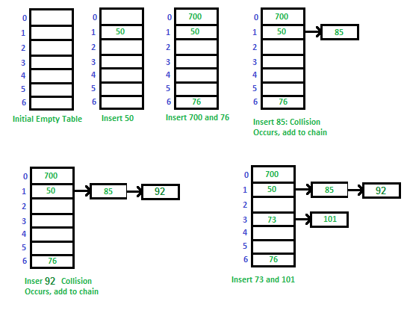
A simple hash function as “key mod 7” and sequence of keys as 50, 700, 76, 85, 92, 73, 101.
Notes:
Instead we must somehow mark the location as "a location that used to have something here, but no longer does."
We might do this by using some other special value for the Number field of the record.
In any case, a search can not stop when it reaches "a location that used to have something here". A search can only stop when it reaches a true empty spot.

Slide 9
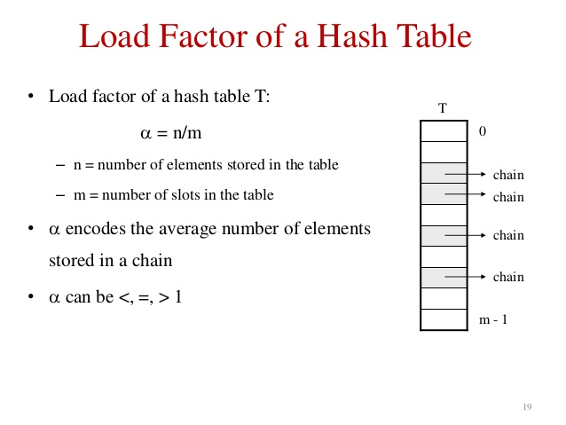
. . .
Notes:
Instead we must somehow mark the location as "a location that used to have something here, but no longer does."
We might do this by using some other special value for the Number field of the record.
In any case, a search can not stop when it reaches "a location that used to have something here". A search can only stop when it reaches a true empty spot.

Slide 10
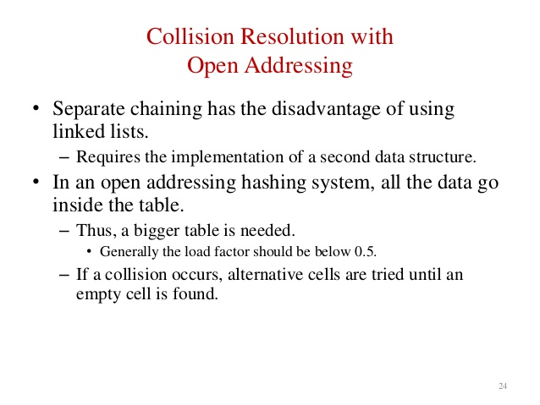
Notes:
A quick summary . . .

Slide 11
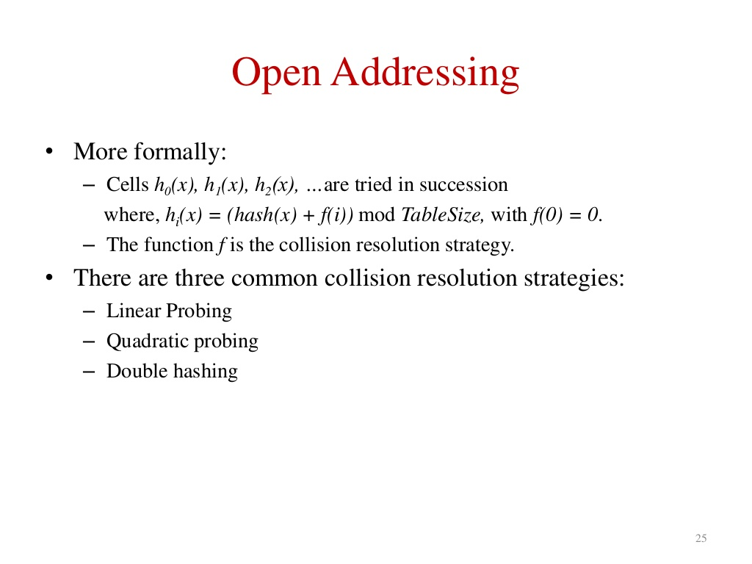
Notes:
A quick summary . . .

Slide 12
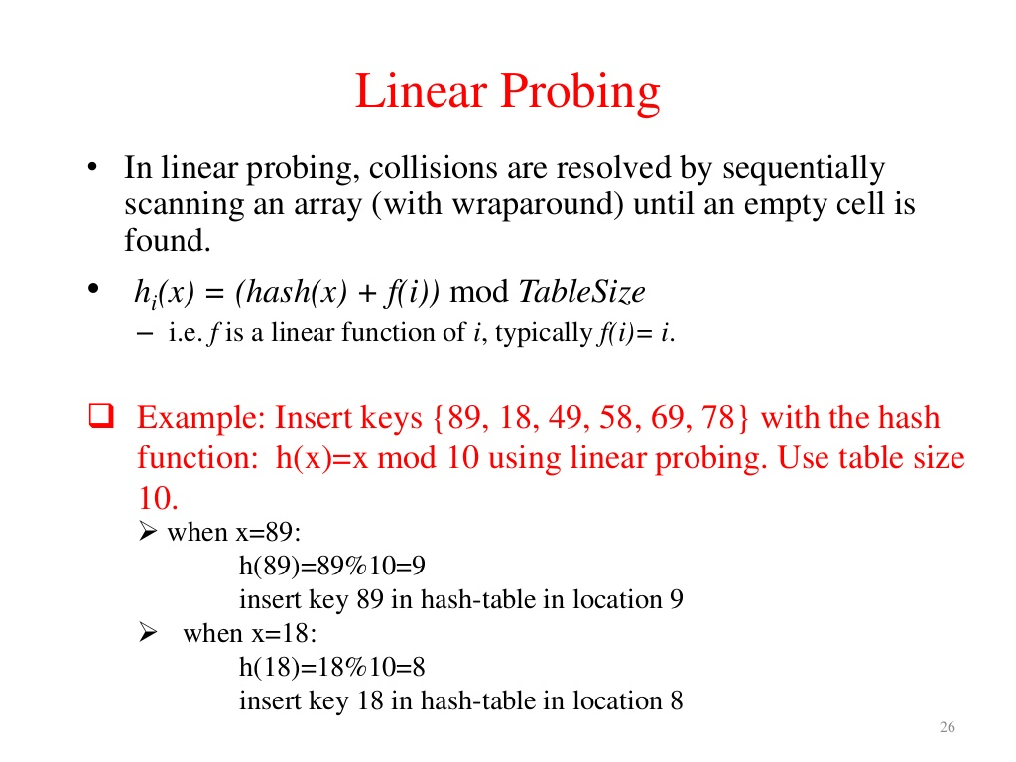
H(X) = X % TS
Notes:
A quick summary . . .

Slide 13
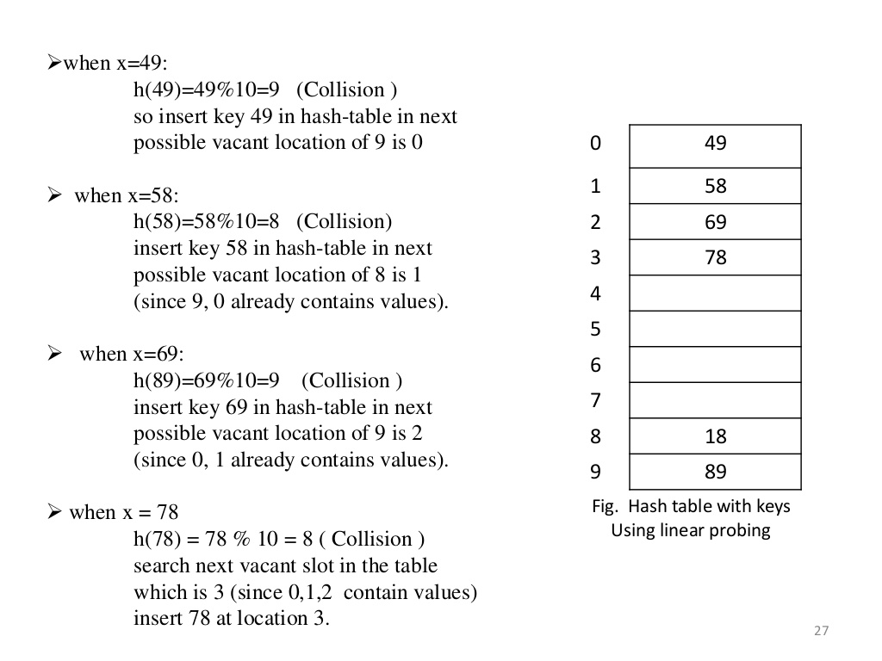
Notes:
A quick summary . . .

Slide 14
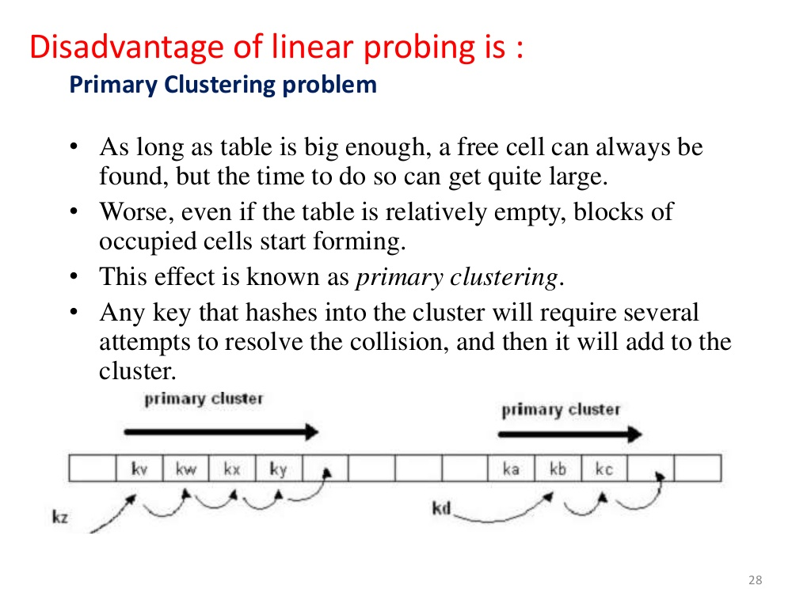
Notes:
A quick summary . . .

Slide 15
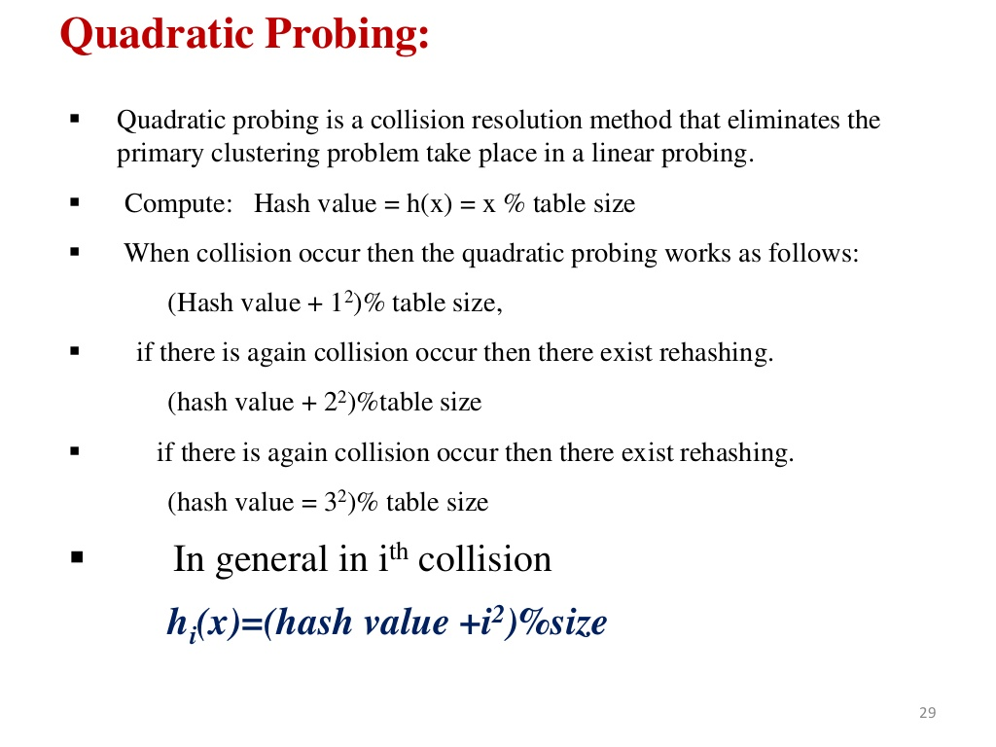
H(X) = X % TS
H_{i}(X) = (X + (i²)) % TS
Notes:
A quick summary . . .

Slide 16
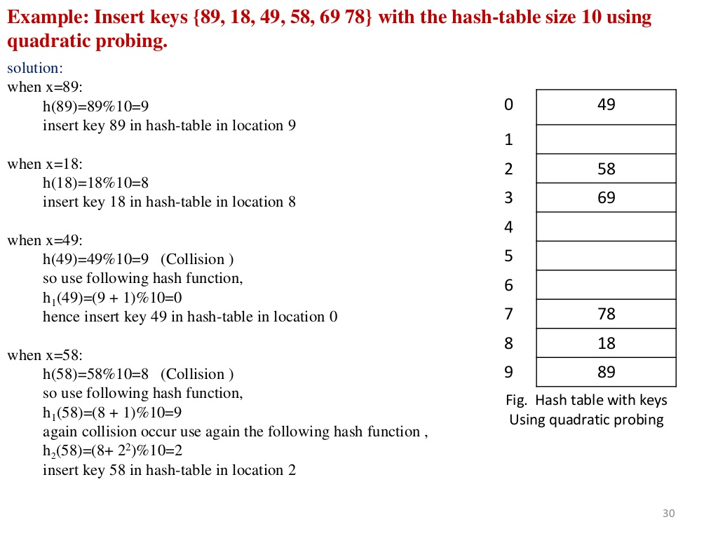
H(X) = X % TS
H_{i}(X) = (X + (i²)) % TS
Notes:
A quick summary . . .

Slide 17
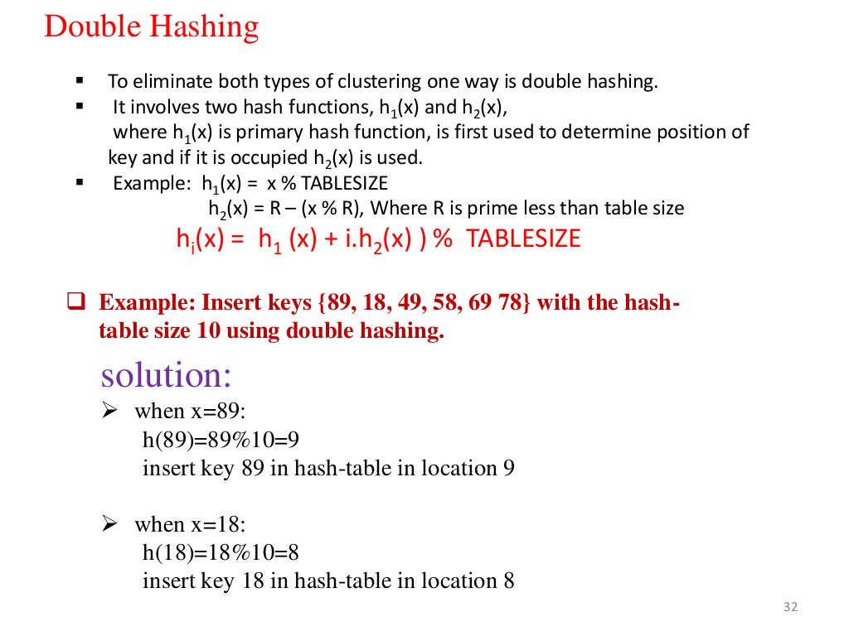
H₁(X) = X % TS
H₂(X) = R-(X%R)
H(X) = (H₁(X) +H₂(X)) % TS
R is a prime number & R< table size.
Notes:
A quick summary . . .

Slide 18
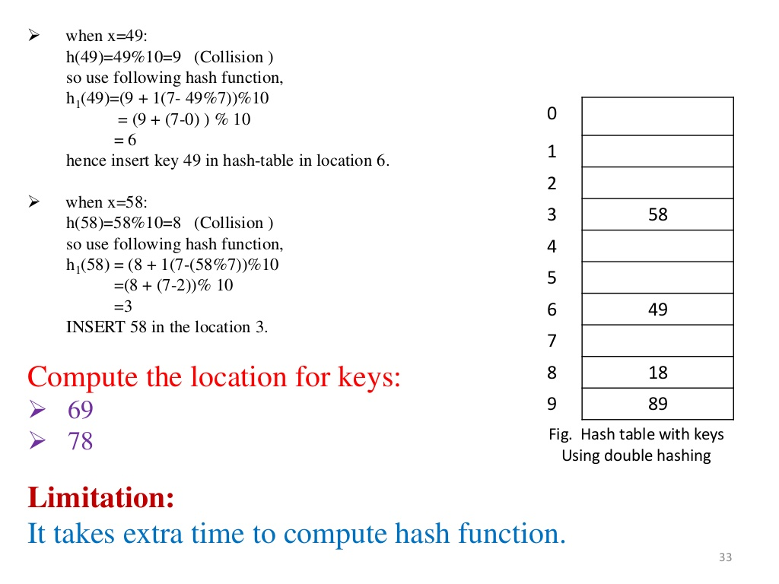
H₁(X) = X % TS
H₂(X) = R-(X%R)
H(X) = (H₁(X) +H₂(X)) % TS
R is a prime number & R< table size.
Notes:
A quick summary . . .

Slide 19
What Is Hashing in Python?
Hashing converts input data, such as a string, file, or object, into a fixed-size string of bytes. The hash or digest represents the input in a unique and reproducible way.
Hashing plays a significant role in detecting data manipulation and enhancing security. It can compute a hash value for a file, message, or other piece of data. An application stores the hash securely to verify later that the data has not been tampered with.
One of the most common uses of hashing in security is password storage. Hashing is a viable alternative to storing plain text passwords in a database. When a user enters their password, the system hashes it before storing it in the database. If a hacker accesses the database, they’ll find that the password is hard to steal.
Python hashing functions make all this possible. These mathematical functions let an application manipulate data into hash values.

Slide 20
Hashing Use Cases
Once you have an adequate hashing function with all these characteristics, you can apply it to various use cases. Hashing functions work well for:
Password storage — Hashing is one of the best ways to store user passwords in modern systems. Python combines various modules to hash and secure passwords before storing them in a database.
Caching — Hashing stores a function’s output to save time when calling it later.
Data retrieval — Python uses a hash table with a built-in dictionary data structure to quickly retrieve values by key.
Digital signatures — Hashing can verify the authenticity of messages that have digital signatures.
File integrity checks — Hashing can check a file’s integrity during its transfer and download.

Slide 21
Python’s Built-In Hashing Function
Python’s built-in hashing function, returns an integer value representing the input object.
The code then uses the resulting hash value to determine the object’s
location in the hash table.
This hash table is a data structure that implements dictionaries and sets.

